Slide 1
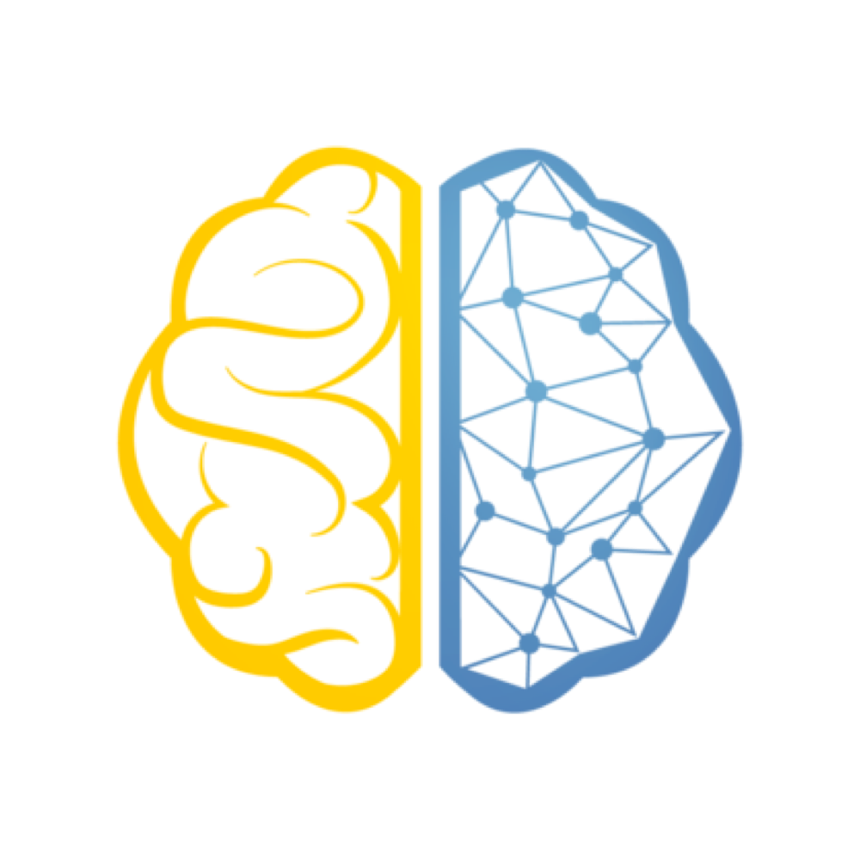

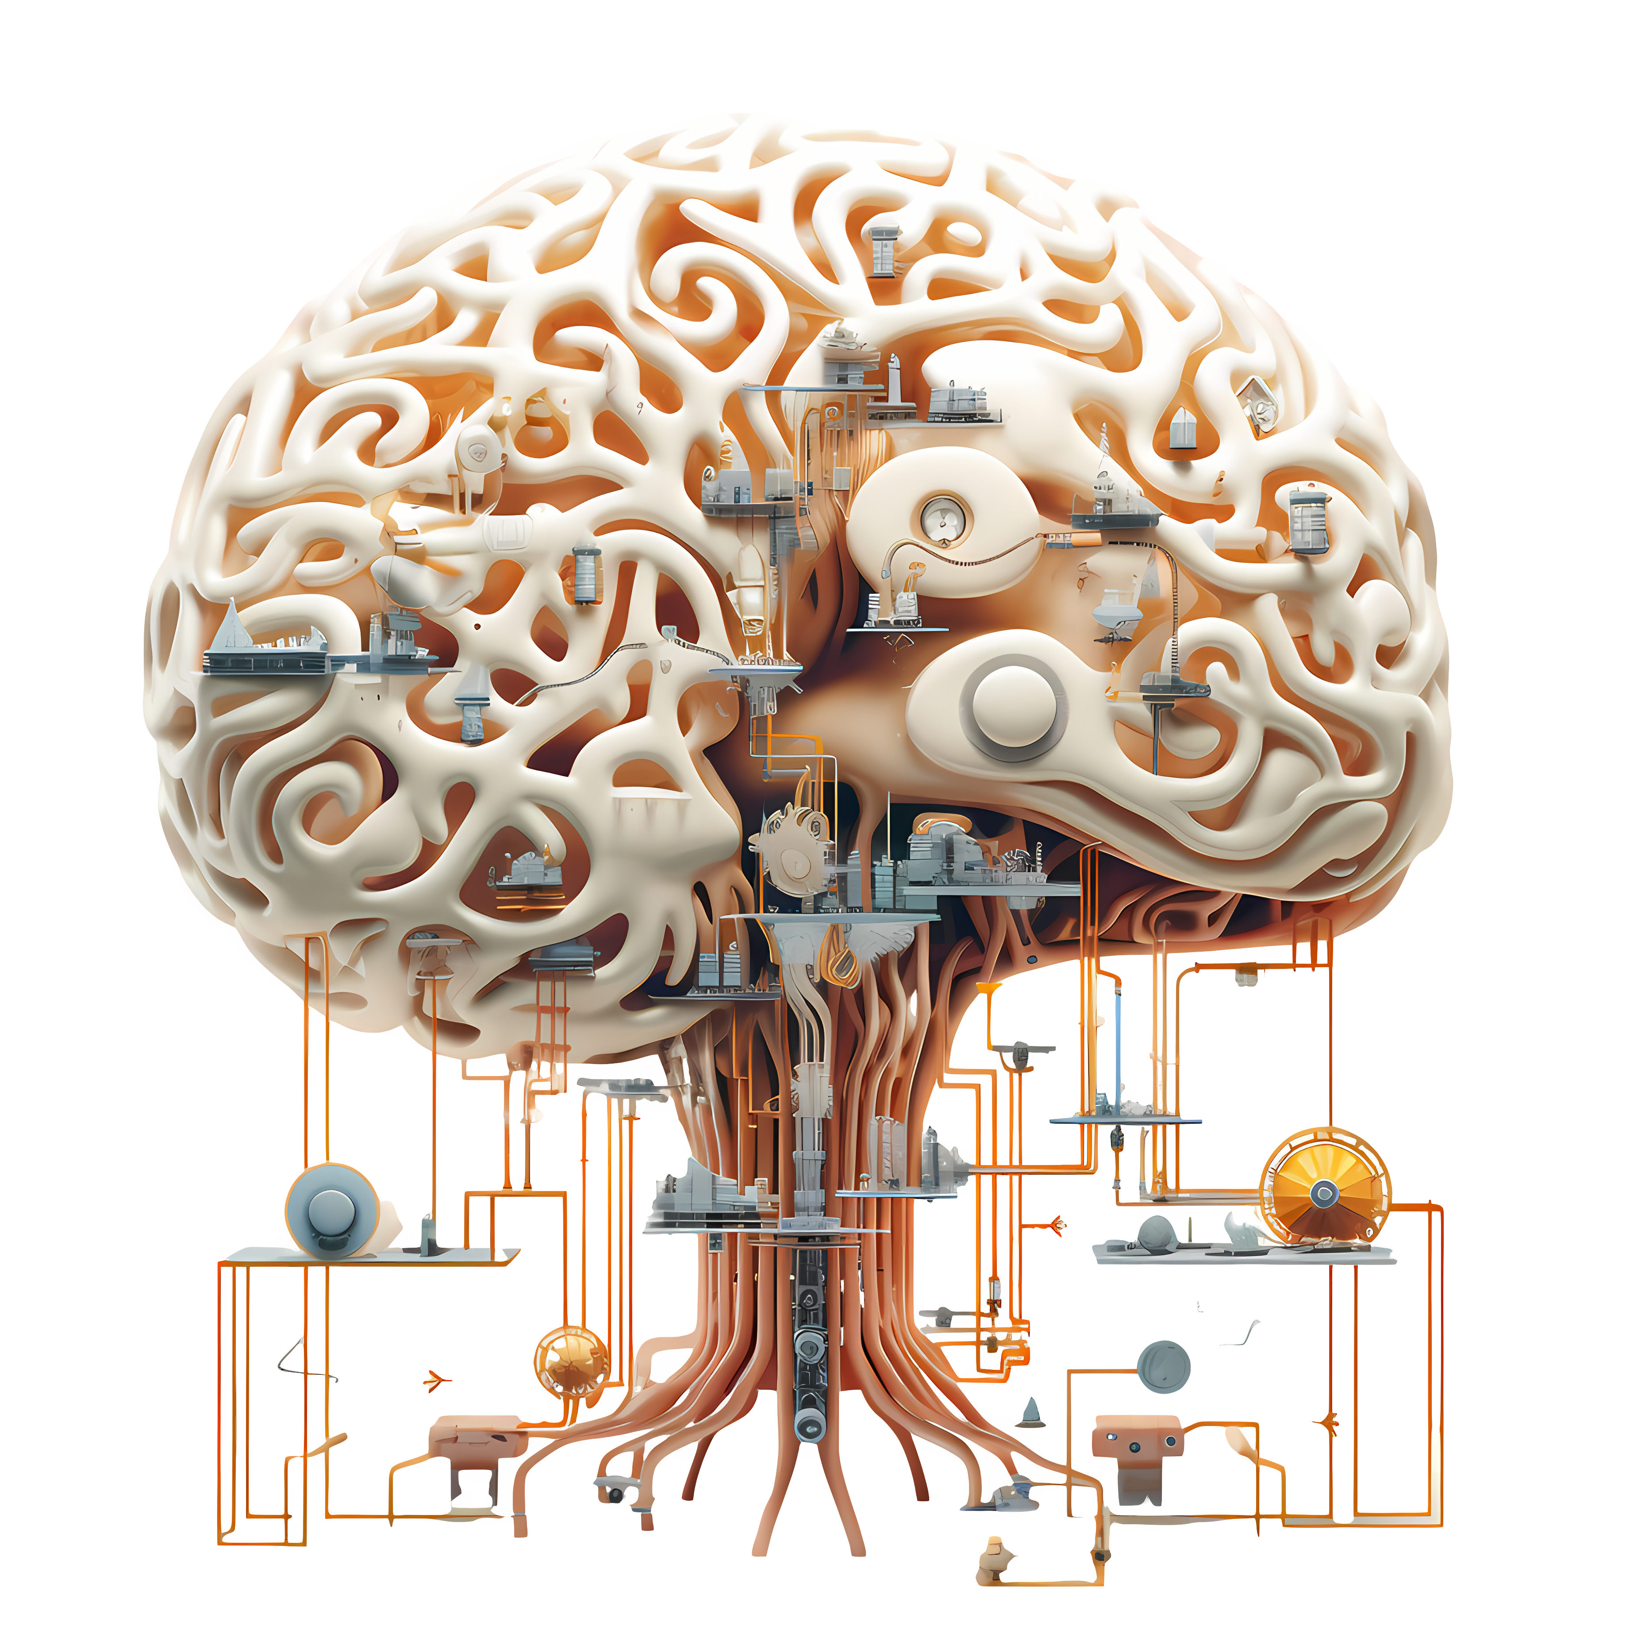

Introduction To Deep Learning
EXPLORATION INTO THE WORLD OF DEEP LEARNING
Ganesh Chowdhary Pinnamaneni

Slide 2
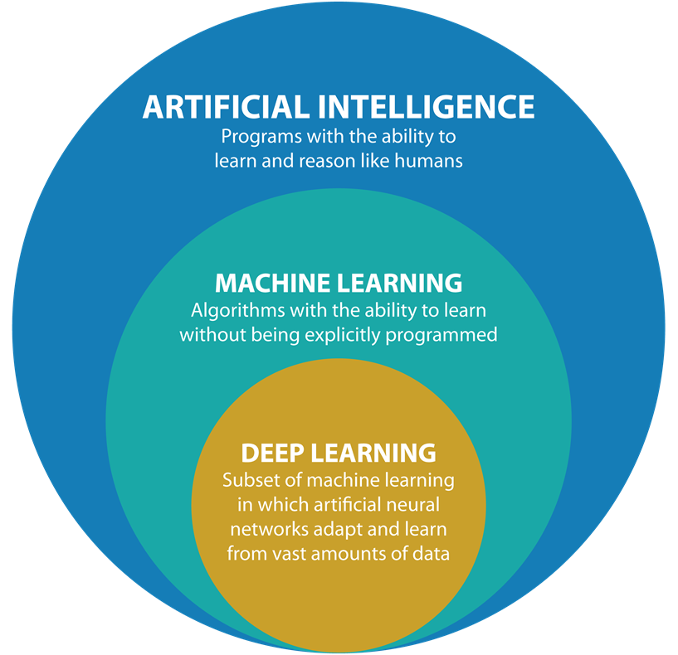
History of Deep Learning (:- ->
Deep learning, the bedrock of modern artificial intelligence, traces its roots back to the visionary work of Warren McCulloch and Walter Pitts in the 1940s. They conceptualized a mathematical model for neurons, laying the foundation for what would become neural networks. Fast forward to 1958, when Frank Rosenblatt introduced the perceptron, an early iteration of neural networks.
However, progress faced a setback during the AI winter of the 1970s and 1980s. Limited computational power and inadequate data stifled advancements, leading to a temporary lull in AI research funding. It wasn't until the 1990s that neural networks saw a revival, thanks to breakthroughs like the backpropagation algorithm and the pioneering work of researchers like Yann LeCun in developing convolutional neural networks (CNNs).

Slide 3
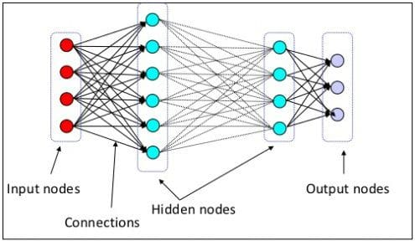
Terminology Behind Deep Learning (:- ->
What actually Deep Learning means ? :- Deep Learning is the process of applying deep neural network technologies to solve problems. Deep neural networks are neural networks with one hidden layer minimum
What is Artificial Neural Network ? :- Actually, artificial neural networks (ANNs) alone (the non-deep variety) have been around for a very long time, and have been able to solve certain types of problems historically.
The Deep Learning architecture was originally inspired by the Biological Brain (particularly the neuron) by which deep learning is carried out.
Popular publications propagate the idea that ANNs are somehow an exact replica of what's going on in the human (or other biological) brain.

Slide 4
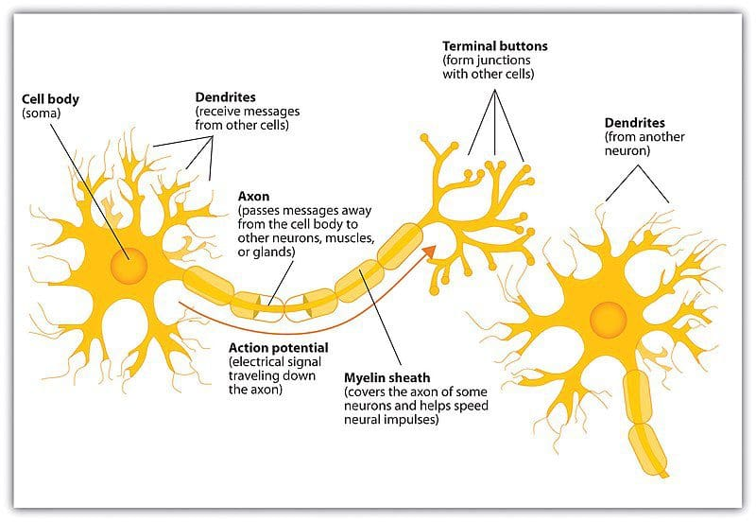
How does Biological Neuron Looks Like ? :-
The major components of the biological neuron of interest to us are:
The nucleus holds genetic information (i.e. DNA)
The cell body processes input activations and converts them to output activations
Dendrites receive activations from other neurons
Axons transmit activations to other neurons
The axon endings, along with neighboring dendrites, form the synapses between neurons
Chemicals called Neurotransmitters then diffuse across the synaptic cleft between an axon ending and a neighboring dendrite, constituting a Neurotransmission.

Slide 5
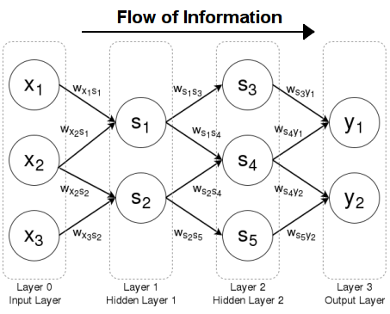
Feedforward Neural Network :-
→ Feedforward neural networks are the simplest form of neural network architecture, in which connections are non-cyclical. The original artificial neural network, information in a feedforward network advances in a single direction from the input nodes, though any hidden layers, to the output nodes; no cycles are present.
Feedforward networks differ from later, recurrent network architectures in which connections form a directed cycle.
Activation Function
In neural networks, the activation function produces the output decision boundaries by combining the network's weighted inputs. Activation functions range from identity (linear) to sigmoid (logistic, or soft step) to hyperbolic (tangent) and beyond. In order to employ backpropagation the network must utilize activation functions which are differentiable.
Sigmoid Activation Function :- Used in the output layer for binary classification.
Softmax Activation Function :- Used in the output layer for multi-class classification → (raw scores into probabilities)

Slide 6
“ It’s Time to get hands-on with a project! Let's turn learning into action.”
Project Title :- Fashion Mnist Clothing Classification
Data Description :-
The Fashion-MNIST dataset is proposed as a more challenging replacement dataset for the MNIST dataset.
It is a dataset comprised of 60,000 small square 28×28 pixel grayscale images of items of 10 types of clothing, such as shoes, t-shirts, dresses, and more. The mapping of all 0-9 integers to class labels is listed below.
0: T-shirt/top
1: Trouser
2: Pullover
3: Dress
4: Coat
5: Sandal
6: Shirt
7: Sneaker
8: Bag
9: Ankle boot
What we use :- Tensorflow

Slide 7

Check out these amazing resources …… ☺
Introduction to Deep Learning
Information about Fashion Mnist
Deep_learning Overview
Harvard-university-cs50
Loss Functions in Deep Learning

